Slide 1
Contemporary Economic Issues ECON-204
Trade and Resources: The Heckscher–Ohlin Model
Instructor: Muhebullah Karimzada
Notes:
If this PowerPoint presentation contains mathematical equations, you may need to check that your computer has the following installed:
1) MathType Plugin
2) Math Player (free versions available)
3) NVDA Reader (free versions available)

Slide 2
Questions to Consider
Why does the United States export agricultural products and airplanes?
What country has the most capital (i.e., factories) as compared with its GDP?
How does trade affect the earnings of labor and capital?

Slide 3
Introduction (part 1)
In this lecture, we outline the Heckscher–Ohlin (HO) model, a model that assumes that trade occurs because countries have different resources.
Canada has a large amount of land and therefore exports agricultural and forestry products, as well as petroleum.
The United States, Western Europe, and Japan have many highly skilled workers and much capital, and these countries export sophisticated services and manufactured goods.
Asian countries have a large number of workers and moderate but growing amounts of capital, and they export less sophisticated manufactured goods.

Slide 4
Introduction (part 2)
Our first goal is to describe the Heckscher–Ohlin (HO) model of trade.
The specific-factors model that we studied in the previous lecture was a short-run model because capital and land could not move between the two industries.
In contrast, the HO model is a long-run model because all factors of production can move between the industries.

Slide 5
Introduction (part 3)
Our second goal is to examine the empirical evidence on the Heckscher–Ohlin model. To obtain better predictions, we extend the model:
By allowing for more than two factors of production
By also allowing countries to differ in their technologies, as in the Ricardian model
Both of these extensions make the predictions from the Heckscher–Ohlin model match more closely the trade patterns in the world economy today.
The third goal of the lecture is to investigate how the opening of trade between two countries affects the payments to labor and to capital in each of them.

Slide 6
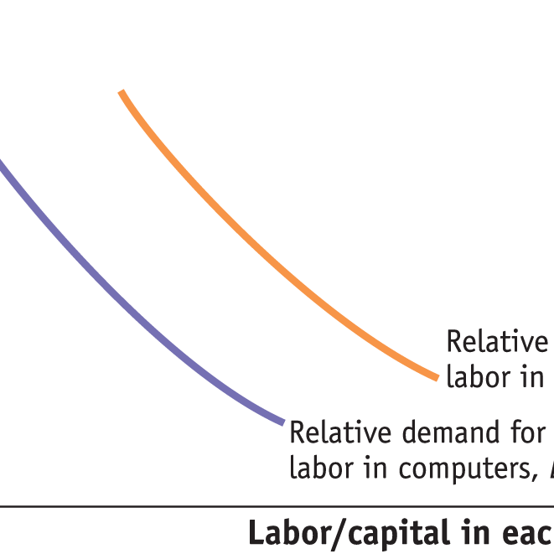
1) Heckscher–Ohlin Model (part 1)
Assumptions of the Heckscher–Ohlin Model
Assumption 1: Both factors, labor and capital, can move freely between the industries.
Assumption 2: Shoe production is labor-intensive; that is, it requires more labor per unit of capital to produce shoes than computers, so L_{S}/K_{S} > L_{C}/K_{C} .
FIGURE 4-1
Labor Intensity of Each Industry
Shoe production being more labor-intensive than computers implies:
L_{S}/K_{S} > L_{C}/K_{C}
These two curves slope down just like regular demand curves, but in this case, they are relative demand curves for labor.

Slide 7


1) Heckscher–Ohlin Model (part 2)
Assumptions of the Heckscher–Ohlin Model
Assumption 3: Foreign is labor-abundant, by which we mean that the labor–capital ratio in Foreign exceeds that in Home,
${\overline{L}}^{∗}$/${\overline{K}}^{∗}> \overline{L}/\overline{K}$
Equivalently, Home is capital-abundant, so that
$\overline{K}/\overline{L}$ > ${\overline{K}}^{∗}$/${\overline{L}}^{∗}$.
Assumption 4: The final outputs, shoes and computers, can be traded freely (i.e., without any restrictions) between nations, but labor and capital do not move between countries.
Assumption 5: The technologies used to produce the two goods are identical across the countries.
Assumption 6: Consumer tastes are the same across countries, and preferences for computers and shoes do not vary with a country’s level of income.

Slide 8
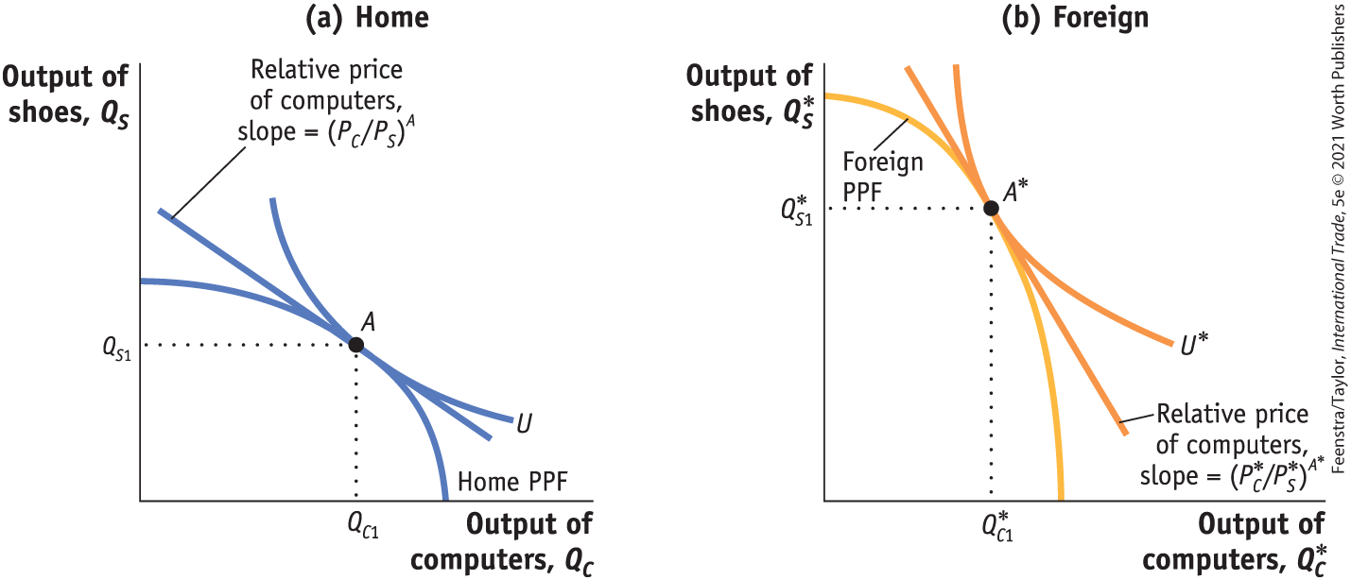
1) Heckscher–Ohlin Model (part 3)
No-Trade Equilibrium
Production Possibilities Frontiers, Indifference Curves, and No-Trade Equilibrium Price
FIGURE 4-2 (1 of 3) No-Trade Equilibria in Home and Foreign
The Home production possibilities frontier (PPF) is shown in panel (a), and the Foreign PPF is shown in panel (b).
Because Home is capital-abundant and computers are capital-intensive, the Home PPF is skewed toward computers.

Slide 9
1) Heckscher–Ohlin Model (part 4)
No-Trade Equilibrium
Production Possibilities Frontiers, Indifference Curves, and No-Trade Equilibrium Price
FIGURE 4-2 (2 of 3) No-Trade Equilibria in Home and Foreign
Home preferences are summarized by the indifference curve, U.
The Home no-trade (or autarky) equilibrium is at point A.
The flat slope indicates a low relative price of computers, (P_{C}/P_{S})^{A}.

Slide 10
1) Heckscher–Ohlin Model (part 5)
No-Trade Equilibrium
Production Possibilities Frontiers, Indifference Curves, and No-Trade Equilibrium Price
FIGURE 4-2 (3 of 3) No-Trade Equilibria in Home and Foreign
Foreign is labor-abundant and shoes are labor- intensive, so the Foreign PPF is skewed toward shoes. Foreign preferences are summarized by the indifference curve, U*.
The Foreign no-trade equilibrium is at point A*, with a higher relative price of computers, as indicated by the steeper slope of (P*_{C}/P*_{S})^{A}*.

Slide 11
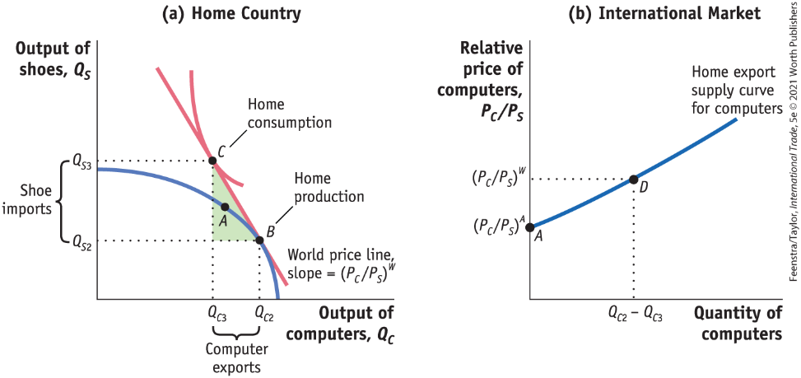
1) Heckscher–Ohlin Model (part 6)
No-Trade Equilibrium
Home Equilibrium with Free Trade
FIGURE 4-3 (1 of 2) International Free-Trade Equilibrium in Home
At the free-trade world relative price of computers, (P_{C}/P_{S})^{W}, Home produces at point B in panel (a) and consumes at point C, exporting computers and importing shoes. Point A is the no-trade equilibrium.
The “trade triangle” has a base equal to the Home exports of computers (the difference between the amount produced and the amount consumed with trade, Q_{C2} − Q_{C3}).

Slide 12
1) Heckscher–Ohlin Model (part 7)
No-Trade Equilibrium
Home Equilibrium with Free Trade
FIGURE 4-3 (2 of 2) International Free-Trade Equilibrium in Home
The height of this triangle is the Home imports of shoes (the difference between the amount consumed of shoes and the amount produced with trade, Q_{S3} − Q_{S2}).
In panel (b), we show Home exports of computers equal to zero at the no-trade relative price, (P_{C/}P_{S})^{A}, and equal to (Q_{C2} − Q_{C3}) at the free-trade relative price, (P_{C}/P_{S})^{W}.

Slide 13
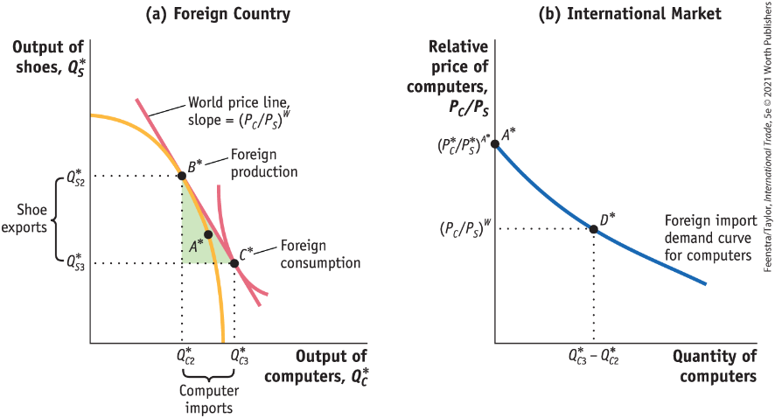
1) Heckscher–Ohlin Model (part 8)
No-Trade Equilibrium
Foreign Equilibrium with Free Trade
FIGURE 4-4 (1 of 2) International Free-Trade Equilibrium in Foreign
At the free-trade world relative price of computers, (P_{C}/P_{S})^{W}, Foreign produces at point B* in panel (a) and consumes at point C*, importing computers and exporting shoes. Point A* is the no-trade equilibrium.
The “trade triangle” has a base equal to Foreign imports of computers (the difference between the consumption of computers and the amount produced with trade, Q*_{C3} − Q*_{C2}).

Slide 14
1) Heckscher–Ohlin Model (part 9)
No-Trade Equilibrium
Foreign Equilibrium with Free Trade
FIGURE 4-4 (2 of 2) International Free-Trade Equilibrium in Foreign
The height of this triangle is Foreign exports of shoes (the difference between the production of shoes and the amount consumed with trade, Q*_{S2} – Q*_{S3}).
In panel (b), we show Foreign imports of computers equal to zero at the no-trade relative price, (P*_{C}/P*_{S})^{A}*, and equal to (Q*_{C3} − Q*_{C2}) at the free-trade relative price, (P_{C} /P_{S})^{W}.

Slide 15
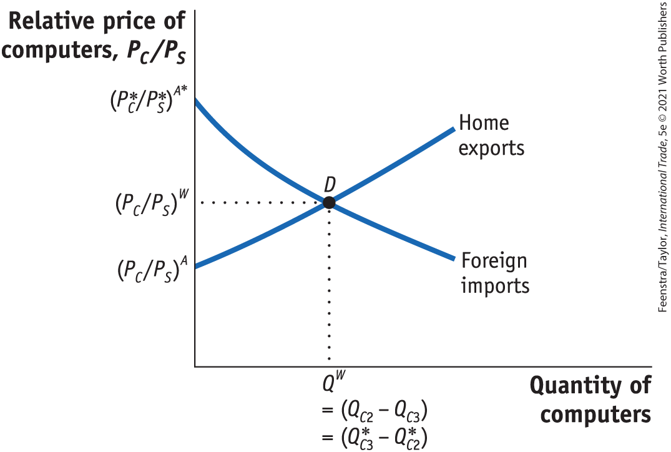
1) Heckscher–Ohlin Model (part 10)
Free Trade Equilibrium
Equilibrium Price with Free Trade
FIGURE 4-5 Determination of the Free-Trade World Equilibrium Price
The world relative price of computers in the free-trade equilibrium is determined at the intersection of the Home export supply and Foreign import demand, at point D.
At this relative price, the quantity of computers that Home wants to export, (Q_{C2} − Q_{C3}), just equals the quantity of computers that Foreign wants to import, (Q*_{C3} − Q*_{C2}).
Notes:
Because exports equal imports, there is no reason for the relative price to change, and so this is a free-trade equilibrium.

Slide 16
1) Heckscher–Ohlin Model (part 11)
Free Trade Equilibrium
Pattern of Trade
Home exports computers, the good that uses intensively the factor of production (capital) found in abundance at Home.
Foreign exports shoes, the good that uses intensively the factor of production (labor) found in abundance there.
This important result is called the Heckscher–Ohlin theorem.
Notes:
Because exports equal imports, there is no reason for the relative price to change, and so this is a free-trade equilibrium.

Slide 17
1) Heckscher–Ohlin Model (part 12)
Heckscher–Ohlin Theorem
Assumption 1: Labor and capital flow freely between the industries.
Assumption 2: The production of shoes is labor-intensive as compared with computer production, which is capital-intensive.
Assumption 3: The amounts of labor and capital found in the two countries differ, with labor abundant in Foreign and capital abundant in Home.
Assumption 4: There is free international trade in goods.
Assumption 5: The technologies for producing shoes and computers are the same across countries.
Assumption 6: Tastes are the same across countries.
Notes:
Because exports equal imports, there is no reason for the relative price to change, and so this is a free-trade equilibrium.

Slide 18
1) Heckscher–Ohlin Model (part 13)
Heckscher–Ohlin Theorem
Conclusions from Assumptions:
When Home opens to trade, its relative price of computers rises from the no-trade equilibrium relative price (P_{C}/P_{S})^{A} to the free-trade equilibrium price (P_{C} /P_{S})^{W}, giving Home firms an incentive to export computers.
Similarly, when Foreign opens to trade, its relative price of computers falls from the no-trade equilibrium price (P*_{C}/P*_{S})^{A}* to the trade equilibrium price (P_{C} /P_{S})^{W} , encouraging Foreign consumers to import computers from Home.
Notes:
Because exports equal imports, there is no reason for the relative price to change, and so this is a free-trade equilibrium.

Slide 19
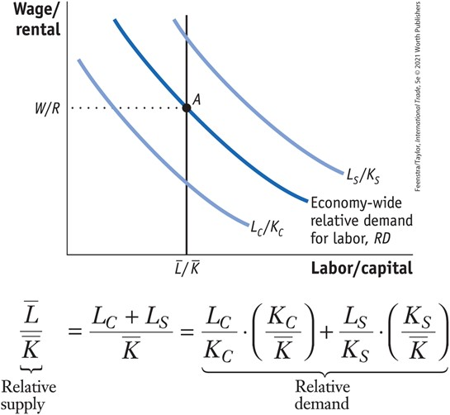
2) Effects of Trade on Factor Prices (part 1)
Effect of Trade on the Wage and Rental of Home
Economy-Wide Relative Demand for Labor
FIGURE 4-11 Determination of Home Wage/Rental
The economy-wide relative demand for labor, RD, is an average of the L_{C}/K_{C} and L_{S}/K_{S} curves and lies between these curves.
The relative supply, L/K, is shown by a vertical line because the total amount of resources in Home is fixed.
The equilibrium point A, at which relative demand RD intersects relative supply L/K, determines the wage relative to the rental, W/R.

Slide 20
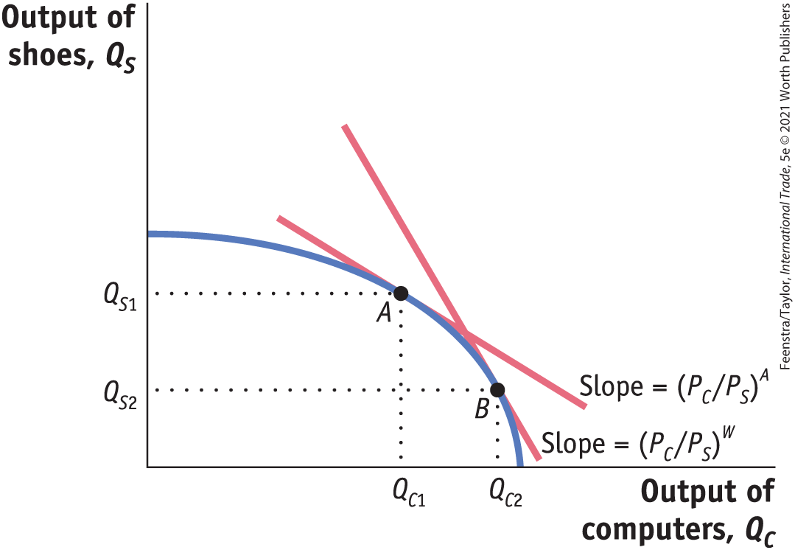
2) Effects of Trade on Factor Prices (part 2)
Effect of Trade on the Wage and Rental of Home
Increase in the Relative Price of Computers
FIGURE 4-12 Increase in the Price of Computers
Initially, Home is at a no-trade equilibrium at point A with a relative price of computers of (P_{C}/P_{S})^{A}.
An increase in the relative price of computers to the world price, as illustrated by the steeper world price line, (P_{C}/P_{S})^{W}, shifts production from point A to B.
At point B, there is a higher output of computers and a lower output of shoes, Q_{C2} > Q_{C1} and Q_{S2} < Q_{S1}.

Slide 21
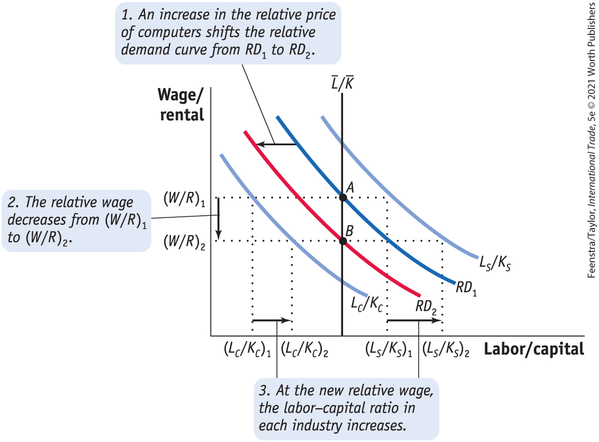
2) Effects of Trade on Factor Prices (part 3)
Effect of Trade on the Wage and Rental of Home
Increase in the Relative Price of Computers
FIGURE 4-13 (1 of 2) Effect of a Higher Relative Price of Computers on Wage/Rental
An increase in the relative price of computers shifts the economy-wide relative demand for labor, RD₁, toward the relative demand for labor in the computer industry, L_{C}/K_{C}. The new relative demand curve, RD₂, intersects the relative supply curve for labor at a lower relative wage, (W/R)₂.

Slide 22
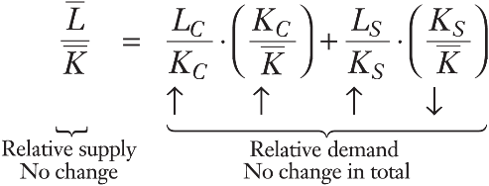
2) Effects of Trade on Factor Prices (part 4)
Effect of Trade on the Wage and Rental of Home
Increase in the Relative Price of Computers
FIGURE 4-13 (2 of 2) Effect of a Higher Relative Price of Computers on Wage/Rental
As a result, the wage relative to the rental falls from (W/R)₁ to (W/R)₂.
The lower relative wage causes both industries to increase their labor–capital ratios, as illustrated by the increase in both L_{C}/K_{C} and L_{S}/K_{S} at the new relative wage.

Slide 23




2) Effects of Trade on Factor Prices (part 5)
Determination of the Real Wage and Real Rental
Change in the Real Rental
$$R=P_{C} ∙ {MPK}_{C} and R=P_{S} ∙ {MPK}_{S}$$
${MPK}_{C}={R/P}_{C}↑and {MPK}_{s}={R/P}_{S}$ $↑$
Change in the Real Wage
$$W=P_{C} ∙ {MPL}_{C} and W=P_{S} ∙ {MPL}_{S}$$
${MPL}_{C}={W/P}_{C}↓and {MPL}_{s}={W/P}_{S}$ $↓$

Slide 24
2) Effects of Trade on Factor Prices (part 6)
Determination of the Real Wage and Real Rental
Stolper–Samuelson Theorem
In the long run, when all factors are mobile, an increase in the relative price of a good will increase the real earnings of the factor used intensively in the production of that good and decrease the real earnings of the other factor.
For our example, the Stolper–Samuelson theorem predicts that when Home opens to trade and faces a higher relative price of computers, the real rental on capital in Home rises and the real wage in Home falls. In Foreign, the changes in real factor prices are just the reverse.

Slide 25
2) Effects of Trade on Factor Prices (part 7)
Changes in the Real Wage and Rental: A Numerical Example
To illustrate the Stolper–Samuelson theorem, we use a numerical example to show how much the real wage and rental can change in response to a change in price.
Computers:
Sales revenue = P_{c} • Q_{c} = 100
Earnings of labor = W • L_{c} = 50
Earnings of capital = R • K_{c} = 50
Shoes:
Sales revenue = P_{s} • Q_{s} = 100
Earnings of labor = W • L_{s} = 60
Earnings of capital = R • K_{s} = 40

Slide 26
2) Effects of Trade on Factor Prices (part 8)
Changes in the Real Wage and Rental: A Numerical Example
Notice that shoes are more labor-intensive than computers:
The share of total revenue paid to labor in shoes is 60/100 = 60%.
This is more than that share in computers: 50/100 = 50%.
When Home and Foreign undertake trade, the relative price of computers rises in Home. For simplicity:
Computers: Percentage increase in price = ΔP_{C}/P_{C} = 10%
Shoes: Percentage increase in price = ΔP_{S} /P_{S} = 0%

Slide 27


2) Effects of Trade on Factor Prices (part 9)
Changes in the Real Wage and Rental: A Numerical Example
The rental on capital can be calculated by taking total sales revenue in each industry, subtracting the payments to labor, and dividing by the amount of capital.
This calculation gives us the following formulas for the rental in each industry:
$R=\frac{P_{C}∙Q_{C}−W∙L_{C}}{K_{C}}$, for computers
$R=\frac{P_{S}∙Q_{S}−W∙L_{S}}{K_{S}}$, for shoes

Slide 28


2) Effects of Trade on Factor Prices (part 10)
Changes in the Real Wage and Rental: A Numerical Example
The price of computers has risen, so Δ P_{C} > 0, holding fixed the price of shoes, Δ P_{S} = 0.
We can trace through how this affects the rental by changing P_{C} and W in the previous two equations:
$R=\frac{P_{C}∙Q_{C}−∆W∙L_{C}}{K_{C}}$, for computers
$R=\frac{0∙Q_{C}−∆W∙L_{S}}{K_{S}}$, for shoes

Slide 29
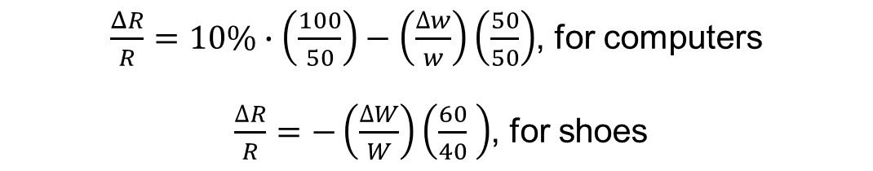
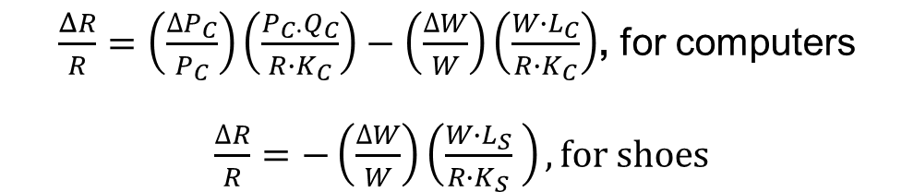
2) Effects of Trade on Factor Prices (part 11)
Changes in the Real Wage and Rental: A Numerical Example
It is convenient to work with percentage changes in the variables. We can introduce these terms into the preceding formulas by rewriting them as:
$\frac{ΔR}{R}=\left(\frac{{∆P}_{C}}{P_{C}}\right)\left(\frac{P_{C∙}Q_{C}}{R∙K_{C}}\right)−\left(\frac{∆W}{W}\right)\left(\frac{W∙L_{C}}{R∙K_{C}}\right)$, for computers
$\frac{∆R}{R}=−\left(\frac{∆W}{W}\right)\left(\frac{W∙L_{S}}{R∙K_{S}} \right), for shoes$
Plug the above data for shoes and computers into these formulas:
$\frac{ΔR}{R}=10\%∙\left(\frac{100}{50}\right)−\left(\frac{∆w}{w}\right)\left(\frac{50}{50}\right)$, for computers
$\frac{∆R}{R}=−\left(\frac{∆W}{W}\right)\left(\frac{60}{40} \right)$, for shoes

Slide 30
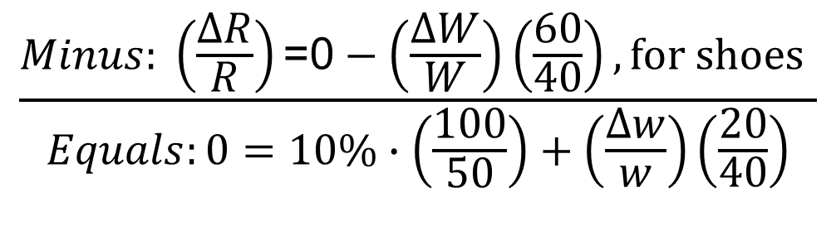
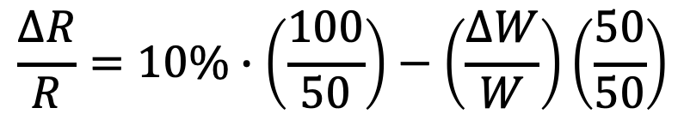
2) Effects of Trade on Factor Prices (part 12)
Changes in the Real Wage and Rental: A Numerical Example
Subtracting one equation from the other, we get
$$\frac{∆R}{R}=10\%∙\left(\frac{100}{50}\right)−\left(\frac{∆W}{W}\right)\left(\frac{50}{50}\right)$$
, for computers
$$\frac{Minus: \left(\frac{∆R}{R}\right)\text{=0}−\left(\frac{∆W}{W}\right)\left(\frac{60}{40}\right),for shoes }{Equals:0=10\%∙\left(\frac{100}{50}\right)+\left(\frac{∆w}{w}\right)\left(\frac{20}{40}\right)}$$

Slide 31
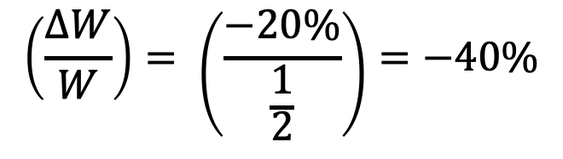
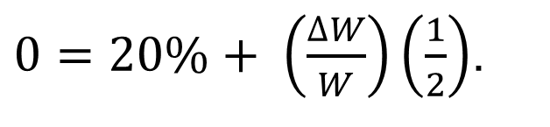

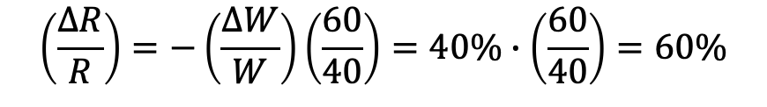
2) Effects of Trade on Factor Prices (part 13)
Changes in the Real Wage and Rental: A Numerical Example
Simplifying the last line, we get
$0=20\%+ \left(\frac{∆W}{W}\right)\left(\frac{1}{2}\right)$.
$$\left(\frac{∆W}{W}\right)= \left(\frac{−20\%}{\frac{1}{2}}\right)=−40\%$$
, change in wages
To find the change in the rental paid to capital (ΔR/R), we can take our solution for ΔW/W = −40% and plug it into the equation for the change in the rental in the shoes sector.
$$\left(\frac{∆R}{R}\right)=−\left(\frac{∆W}{W}\right)\left(\frac{60}{40}\right)=40\%∙\left(\frac{60}{40}\right)=60\%$$
$,$ change in rental

Slide 32
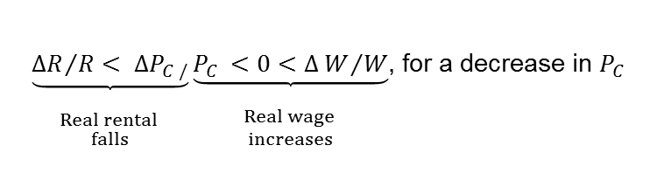

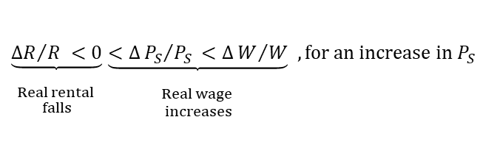
2) Effects of Trade on Factor Prices (part 14)
Changes in the Real Wage and Rental: A Numerical Example
General Equation for the Long-Run Change in Factor Prices
The long-run results of a change in factor prices can be summarized in the following equation:
$\underset{\begin{aligned} \\ Real wage \\ falls\end{aligned}}{\underbrace{∆W/W<0}} \underset{\begin{aligned} \\ Real rental \\ increases\end{aligned}}{\underbrace{<∆P_{c}/P_{c }<∆R/R}}$, for an increase in $P_{C}$
The relationship between the changes in product prices to changes in factor prices is called the “magnification effect” because it shows how changes in the prices of goods have a magnified effect on the earnings of factors.
$\underset{\begin{aligned} \\ Real rental \\ falls\end{aligned}}{\underbrace{{∆R}/{R< ∆P_{C /}}}}\underset{\begin{aligned} \\ Real wage \\ increases\end{aligned}}{\underbrace{P_{C }<0<∆W/W}}$, for a decrease in $P_{C}$
$$\underset{\begin{aligned} \\ Real rental \\ falls\end{aligned}}{\underbrace{{∆R}/{R <0}}}\underset{\begin{aligned} \\ Real wage \\ increases\end{aligned}}{\underbrace{<∆{P_{S}}/{P_{S }<∆W/W}}} , for an increase in P_{S}$$

Slide 33
Conclusions (part 1)
The Heckscher–Ohlin model isolates the effect of different factor endowments across countries and determines the impact of these differences on trade patterns, relative prices of goods between countries, and factor returns.
The Heckscher‒Ohlin model predicts that countries export goods that use their abundant factor intensively.
Leontief paradoxically found that the exports from the United States were relatively labor-intensive. This paradox was explained with later research showing that the United States was abundant in effective labor, as measured by productivity, in 1947.
Adjusting factors of production for their productivity also explains the changing abundancy and scarcity of arable land in the United States and of R&D scientists in China.

Slide 34
Conclusions (part 2)
When firms have differentiated products and increasing returns to scale, the potential exists for gains from trade above and beyond those under perfect competition.
By focusing on the factor intensities among goods (i.e., the relative amount of labor and capital used in production), the Heckscher‒Ohlin (HO) model also explains who gains and who loses from the opening of trade.
The HO model predicts real gains for the factor used intensively in the export good, whose relative price goes up with the opening of trade, and real losses for the other factor.
Having just two factors, both of which are fully mobile between the industries, leads to a clear prediction about who gains and who loses from trade in the long run.

